Slide 1
Review-Entities
Entity – a person, a place, an object, an event, or a concept in the user environment about which the organization wishes to maintain data (often corresponds to a table)
Entity instance – A single occurrence of an entity type (often corresponds to a row in a table)
Entity type – a collection of entities that share common properties or characteristics … An entity type is a template for entity instances

Slide 2
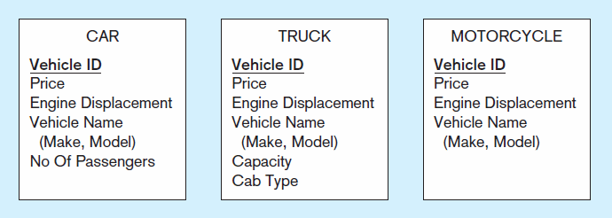
Three entity types: CAR, TRUCK, and MOTORCYCLE
Supertype
Subtypes
All these types of vehicles have the same entity type. They have common attributes … they need to have specific attribute(s) to b a subtype

Slide 3
Three entity types: CAR, TRUCK, and MOTORCYCLE
ID | price | Engine Displacement | Vehicle name | No of passengers | Capacity | Cab type
1 | $50,000 | 2L | Car_A | 4
2 | $60,000 | 4L | Truck_A |  | 6 | Cab over engine
3 | $2,000 | 0.25L | Motocycle_A
ID | price | Engine Displacement | Vehicle name | No of passengers
1 | $50,000 | 2L | Car_A | 4
ID | price | Engine Displacement | Vehicle name | Capacity | Cab type
2 | $60,000 | 4L | Truck_A | 6 | Cab over engine
ID | price | Engine Displacement | Vehicle name
3 | $2,000 | 0.25L | Motocycle_A

Slide 4
Three entity types: CAR, TRUCK, and MOTORCYCLE
ID | price | Engine Displacement | Vehicle name
1 | $50,000 | 2L | Car_A
2 | $60,000 | 4L | Truck_A
3 | $2,000 | 0.25L | Motocycle_A
ID | No of passengers
1 | 4
ID | Capacity | Cab type
2 | 6 | Cab over engine

Slide 5
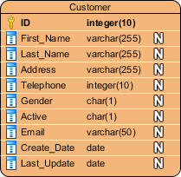
Review-Attributes
Attribute– property or characteristic of an entity or relationship type (often corresponds to a field in a table)
Notes:
5

Slide 6
Review-Attributes: Identifiers (Keys)
Identifier (Key) – an attribute (or combination of attributes) that uniquely identifies individual instances of an entity type
Simple versus Composite Identifier
Candidate Identifier– an attribute (or combination of attributes) that could be a key… satisfies the requirements for being an identifier
Notes:
6

Slide 7
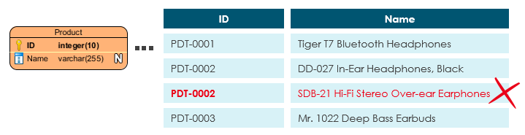
Review-Attributes: Identifiers (Keys)
Notes:
6

Slide 8
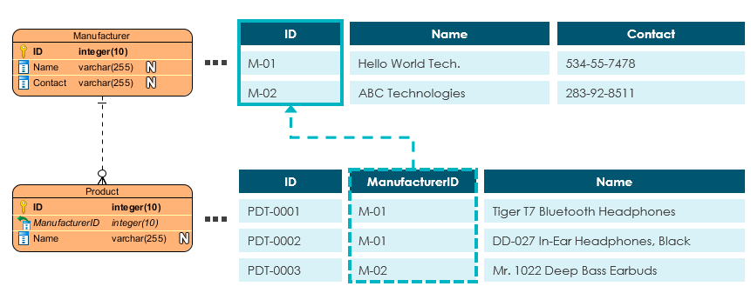
Review-Attributes: Identifiers (Keys)
Notes:
6

Slide 9
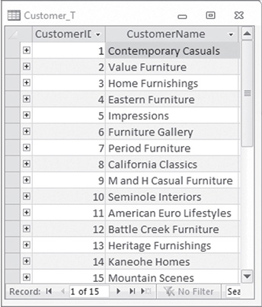
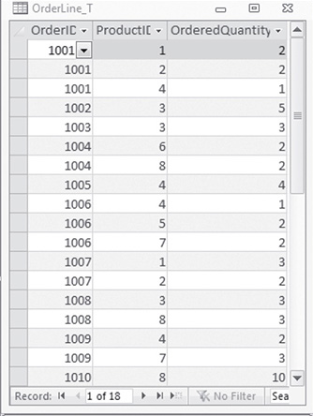
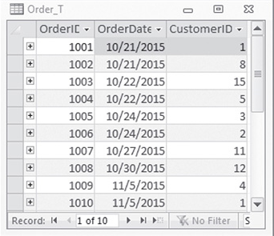
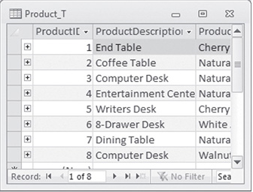
Review-Primary key/Foreign key
Business Rule: any order can be related to many products (related to OrderLine_T)
If two relations (tables) have a relationship, then the PK of the parent relation will be a FK in the dependent relation …
Question: What would be the FK in a relation (table) that need to have a relationship with OrderLine_T?

Slide 10
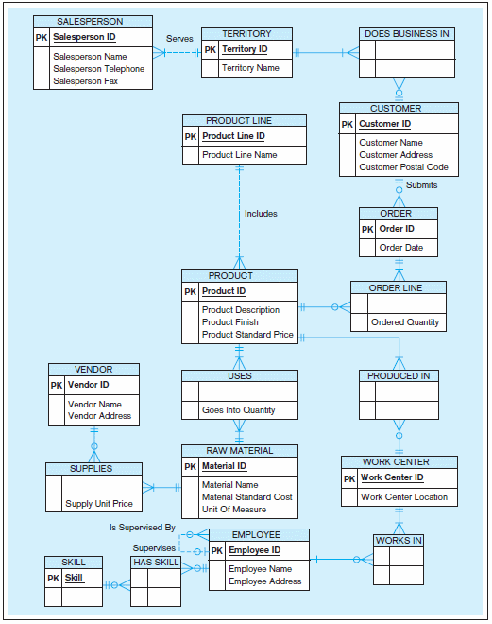
Review-Relationship
Relationship instance:
link between entities ... corresponds to primary key-foreign key equivalencies in related tables)
Relationship type:
Category/model of relationship … link between entity types
Notes:
7

Slide 11
Review-Relationship: Cardinality of Relationships
One-to-One
Each entity in the relationship will have exactly one related entity
One-to-Many
An entity on one side of the relationship can have many related entities, but an entity on the other side will have a maximum of one related entity
Many-to-Many
Entities on both sides of the relationship can have many related entities on the other side

Slide 12
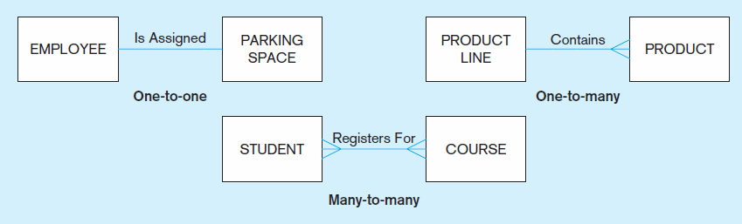
Review-Relationship: Examples of Relationships of Different Degrees
Notes:
22

Slide 13
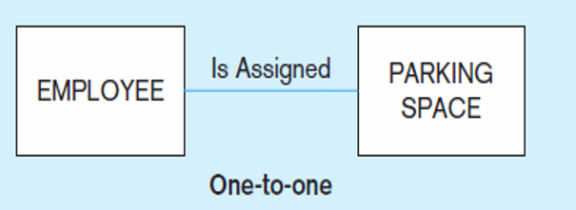
Review-Relationship: Examples of Relationships of Different Degrees
Employee ID | Parking space
20230101 | 1-1-1
Notes:
22

Slide 14
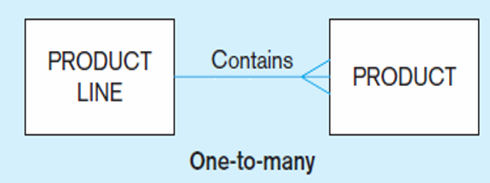
Review-Relationship: Examples of Relationships of Different Degrees
Product Line ID | Production description
1 | Book
2 | Pen
3 | Blackboard and chalk
Product ID | Product Line ID | Product
1 | 1 | Book
2 | 2 | Pen
3 | 3 | Blackboard
4 | 3 | Piece of chalk
Notes:
22

Slide 15
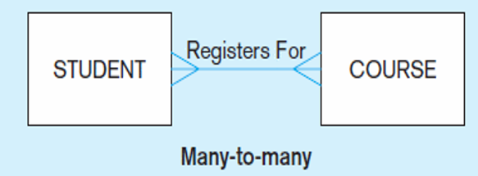
Review-Relationship: Examples of Relationships of Different Degrees
CourseID | Course name
C1 | JAVA
C2 | C
C3 | C++
C4 | Python
SID | name
S1 | AA
S2 | BB
S3 | CC
SID | CourseID
S1 | C1
S2 | C1
S1 | C2
Notes:
22

Slide 16
Review-Relationship: Cardinality Constraints
Cardinality Constraints— the number of instances of one entity that can or must be associated with each instance of another entity
Minimum Cardinality
If zero, then optional
If one or more, then mandatory
Maximum Cardinality
The maximum number
Notes:
29

Slide 17
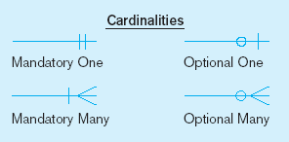
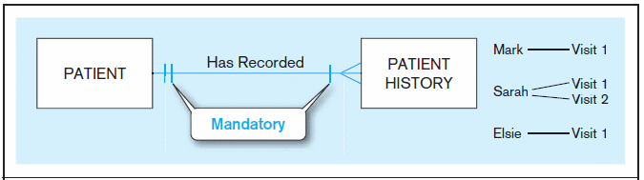
Review-Relationship: Examples of Cardinality Constraints
a) Mandatory cardinalities
A patient history is recorded for one and only one patient
A patient must have recorded at least one history, and can have many
Notes:
1

Slide 18
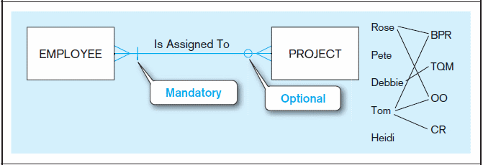
Review-Relationship: Examples of Cardinality Constraints (Figure 2-17) (cont.)
b) One optional, one mandatory
A project must be assigned to at least one employee, and may be assigned to many
An employee can be assigned to any number of projects, or may not be assigned to any at all
Notes:
1

Slide 19
An ERD Example (First draft)
M
1
PERSON
PART
supplies
SUPPLIER
M
N
M
N
stored in
has
manage
USE
1
M
WAREHOUSE
1
M
DEPARTMENT
PROJECT
ERD often contains many entities and relationship sets

Slide 20
Associative Entity and Composite Keys
PERSON-ID NAME ADDRESS
Attributes specific to the Person entity
PERSON
1
M
Composite Primary key
Works
For
PERSON-ID PROJECT-ID TIME-SPENT
ASSIGNMENT
WORK
M
Attributes specific to the relationship
1
PROJECT
PROJECT-ID START-DATE BUDGET
Attributes specific to the Project entity

Slide 21
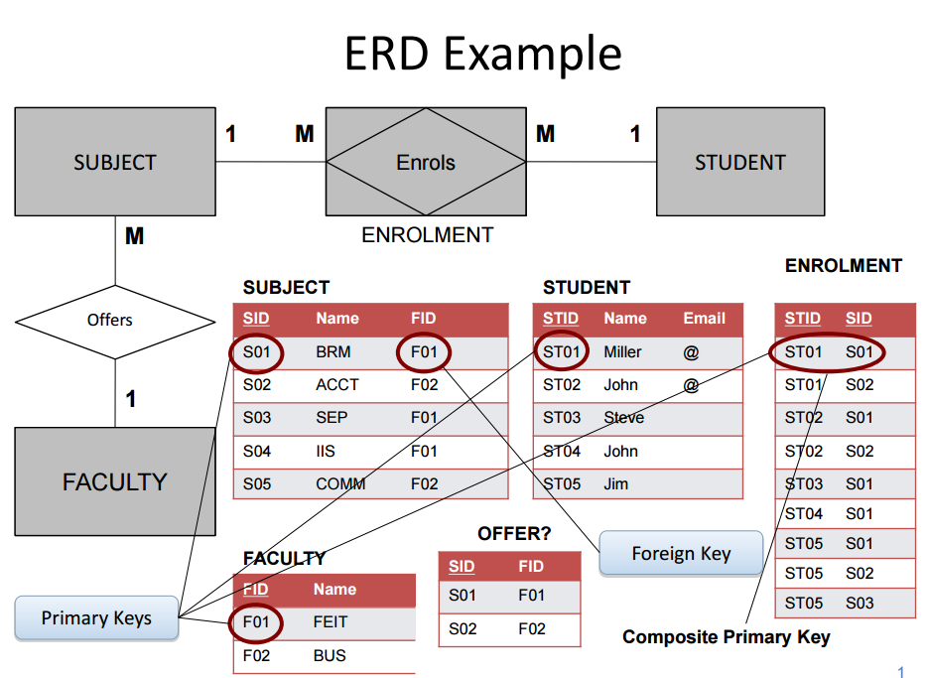
Example of an ERD and a Database
This is an example of an ERD that we BAs draw. Your database experts in your IT development team will convert our ERD into a proper database. We work with them.
This is a database showing its tables. It is not an ERD. Your database experts will convert our (BAs) ERD into these tables in a database.

Slide 22
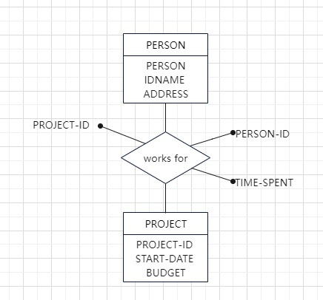
You could draw it like this
This is the best
Notes:
1

Slide 23
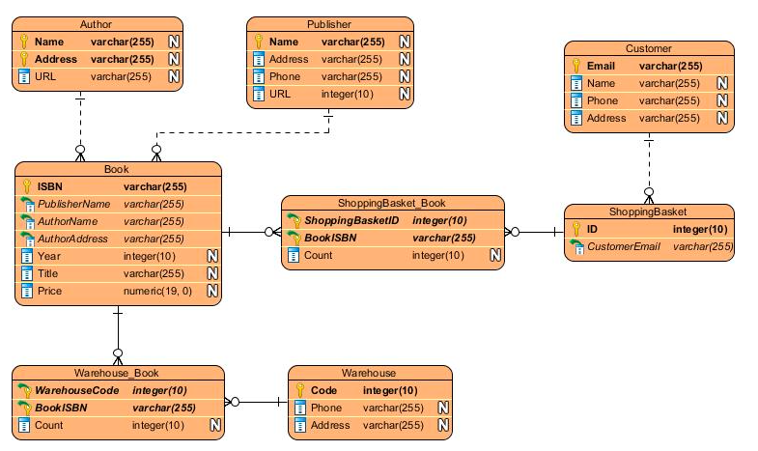
Or you could draw it like this
Notes:
1

Slide 24
Tutorial 3.2
1. Main data structure
2. (Primary) Keys
3. Attributes
Notes:
1

Slide 25
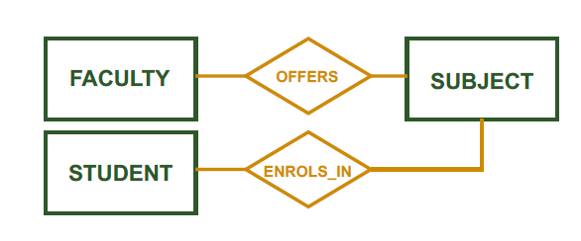
Tutorial 3.2
1. Main data structure
• Identify Entities
• Identify Relationships
Notes:
1

Slide 26
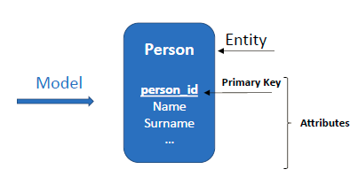
Tutorial 3.2
2. (Primary) Keys
How do I identify my entities in the system?
• Entity Primary Key
• Explicit Relationship Primary Key
Notes:
1

Slide 27
Tutorial 3.2
3. Attributes
Add most relevant attributes
Notes:
1

Slide 28
Tutorial 3.2
Test your model (ALWAYS)
Is the model correct?
• How can I test my model?
1. Generate Tables
2. Populate tables with fake data
Notes:
1

Slide 29
Start doing the tutorial 3.2
Notes:
1

